Slide 1
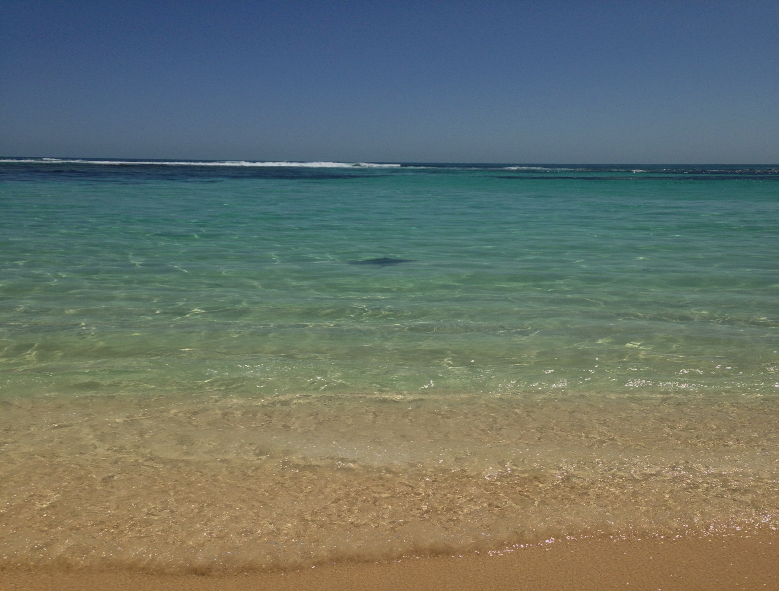
Controlling Maritime Organized Crime
Associate Professor Sarah Percy
University of Western Australia

Slide 2
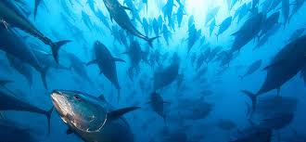
Why does IUU fishing require control?
Why are control efforts failing?
Consequences of control efforts
What can we do differently?

Slide 3
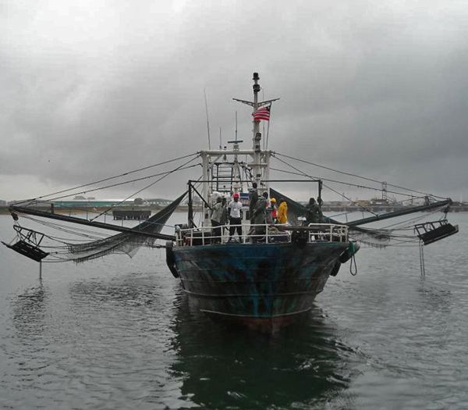
IUU fishing is the engine of maritime crime

Slide 4
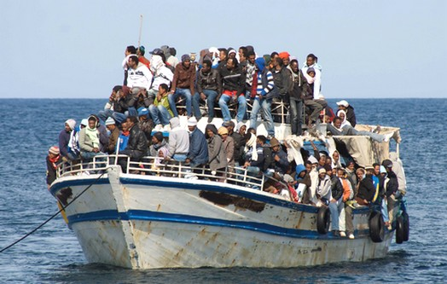
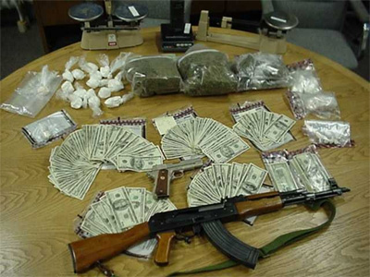
Smuggling
Notes:
Illegal fishing is a SECURITY PROBLEM as well as a FISHERIES PROBLEM

Slide 5
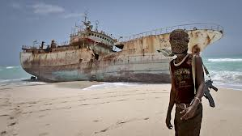
Good legal frameworks matter

Slide 6
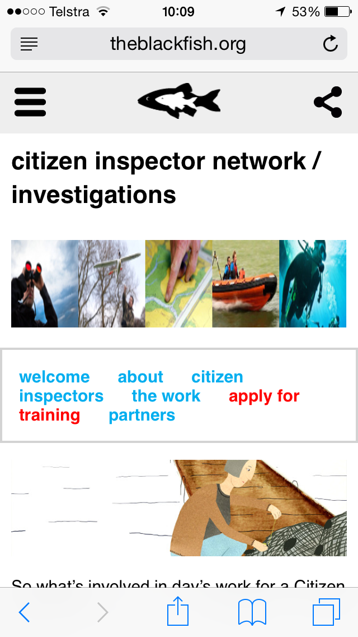
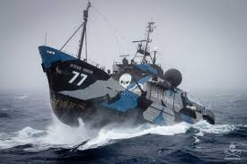
International Vigilantes

Slide 7
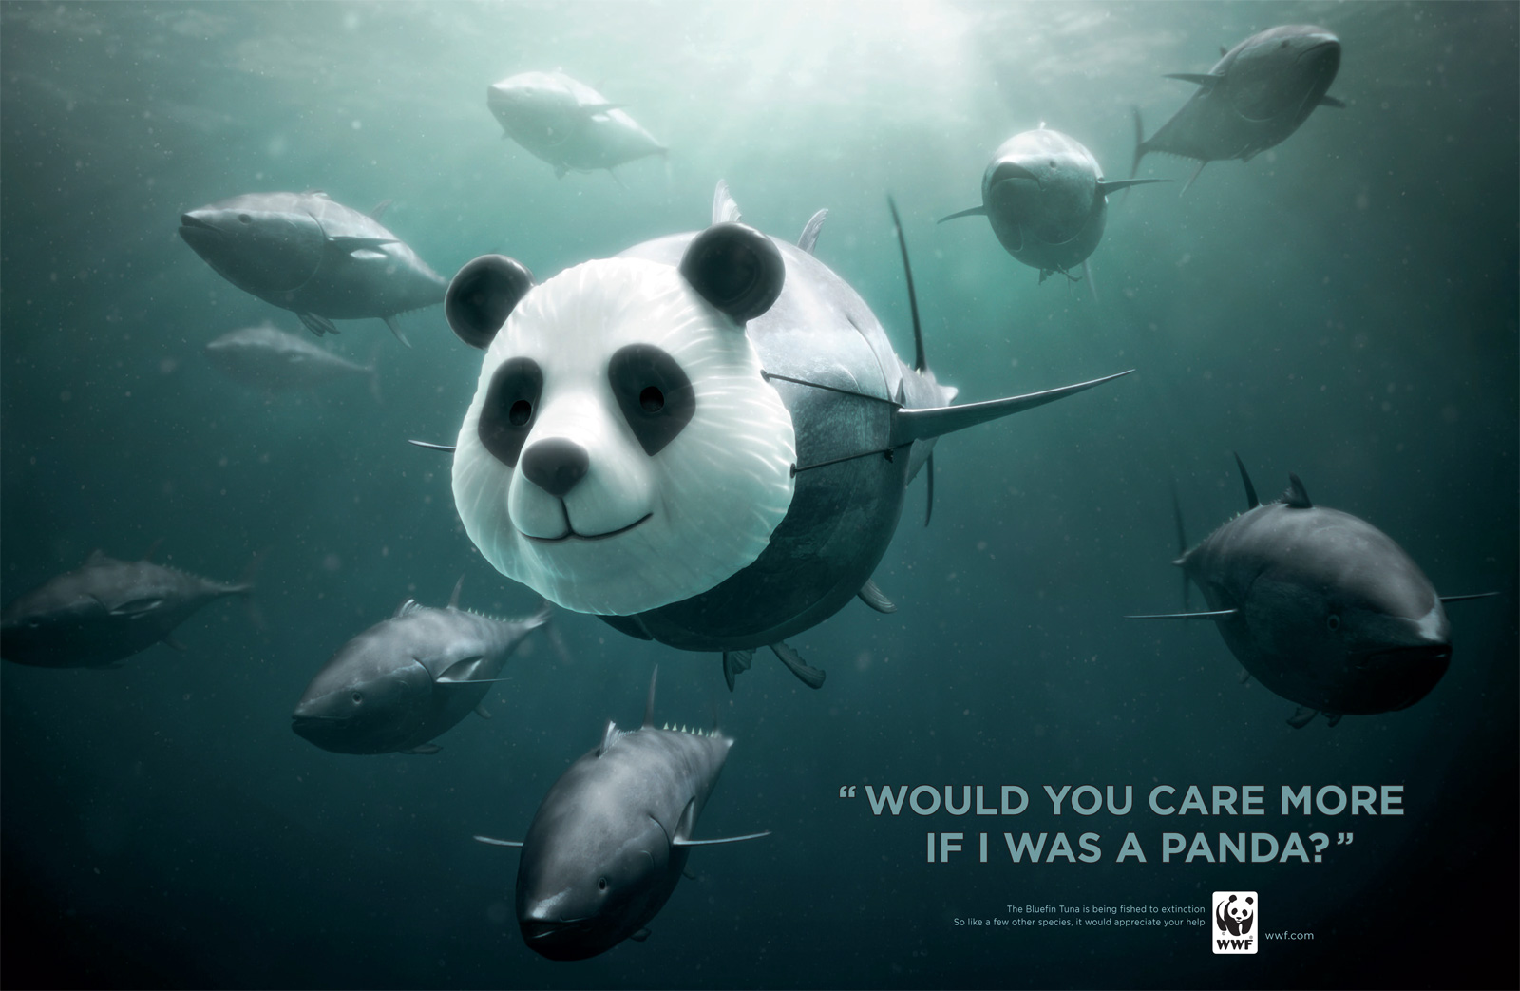
Public attention

Slide 8
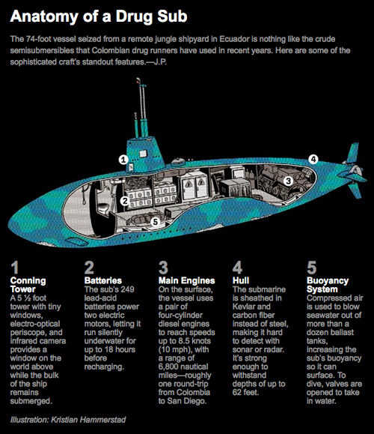

Slide 9
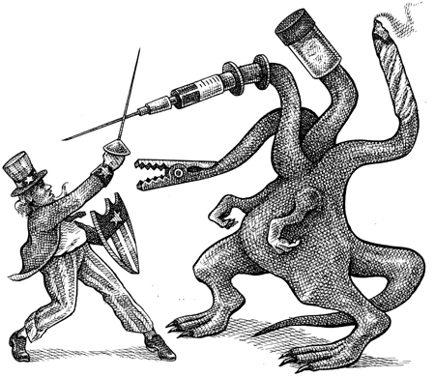
Notes:
Open-ended, uncertain commitments: militaries hate these
HYDRA:

